Slide 1

Administering InvaFresh ePLUM Scale Management Software

Slide 2
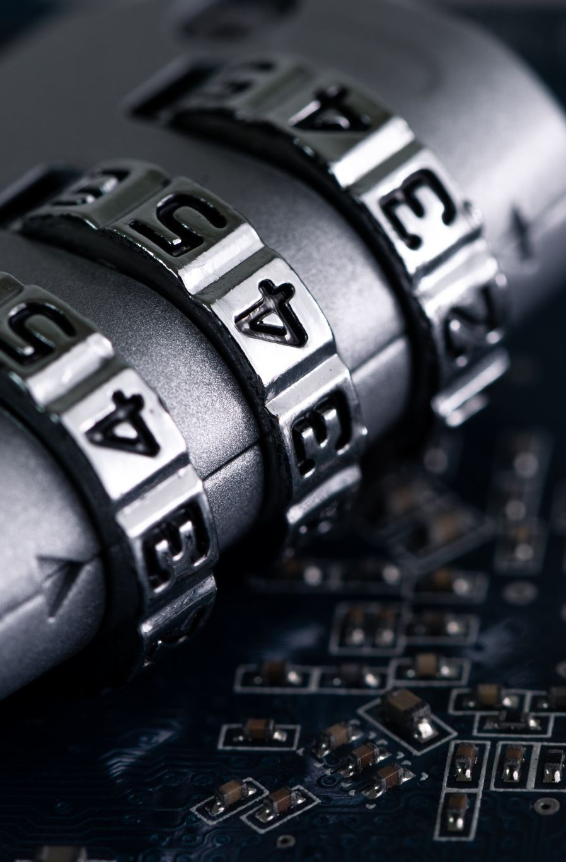
Step 1: Logging In
Access the InvaFresh ePLUM Scale Management Software using your administrator credentials

Slide 3
Step 2: User Management
Navigate to the "User Management" section
Add, modify, or delete user accounts as needed
Assign specific roles and permissions to users based on their responsibilities within the system

Slide 4
Step 3: Scale Configuration
Access the "Scale Configuration" module
Register new scales and update existing scale profiles
Configure scale settings, including communication protocols and calibration parameters

Slide 5
Step 4: Product Setup
Go to the "Product Setup" section
Add new products or update existing product information
Specify product details, such as SKU, description, and pricing

Slide 6

Step 5: Tare Weight Calibration
Configure tare weight calibration for scales
Ensure accurate weight measurements by calibrating tare weights for containers or packaging

Slide 7

Step 6: Data Collection
Set up data collection parameters for scales
Define the frequency and type of data to collect, such as weight, timestamp, and product information

Slide 8
Step 7: Monitoring and Alerts
Monitor real-time weight data from connected scales
Configure alerts and notifications for weight deviations or unusual activity
Take immediate action when alerts are triggered

Slide 9
Step 8: Data Storage
Manage data storage settings
Choose between local and cloud-based storage options
Set data retention policies for compliance and reporting

Slide 10
Step 9: Reporting and Analytics
Access reporting and analytics tools
Generate reports on weight data trends, product performance, and scale efficiency
Analyze data to make informed decisions

Slide 11
Step 10: Maintenance and Calibration
Schedule routine maintenance tasks for scales
Perform regular scale calibrations to ensure accurate weight measurements
Document maintenance activities and calibration results

Slide 12
Step 11: Security and Access Control
Implement security measures to protect data and access
Configure user authentication, authorization, and encryption protocols
Regularly review and update security policies

Slide 13
Step 12: Integration
Integrate the InvaFresh ePLUM Scale Management Software with other systems or databases, if applicable
Ensure seamless data flow between the scale management software and other business applications

Slide 14

Step 13: Backup and Recovery
Set up automated backups of scale data and configurations
Develop a disaster recovery plan to minimize data loss in case of system failures

Slide 15

Step 14: User Training
Provide training to users and operators of the scale management system
Educate them on using the software effectively and adhering to best practices

Slide 16

Step 15: Support and Troubleshooting
Offer technical support to users and address any software-related issues
Maintain a system log for troubleshooting and debugging purposes

Slide 17

Step 16: Compliance
Ensure compliance with industry regulations and standards related to scale management and data security
Keep documentation and records for audit and compliance purposes

